Slide 1



Sentiment & Securities analysis
Brandon Fisher
December 17th 3:30-4:00 pm DUE 2183

Slide 2
Project Description
Do Tweets about a company correlate to its stock price??
Track tweets from business news sources
Track stock prices of major companies
Use Natural Language Processing:
Named Entity Recognition (Companies)
Sentiment Analysis
Could you make money trading with this strategy?

Slide 3
Goals
Original
Database of stock prices for at least 10 major companies
Record of Tweets mentioning these companies
Graphs of sentiment vs. stock price
Stretch Goal
Real-time program to record “purchase decisions” and determine profitability
Revised
Old plan - simulate day-trading with this strategy
New plan - create an interactive visualization app to view data

Slide 4






What Was Implemented:

Slide 5
AWS Lightsail Resources
Linux Instance – 2GB RAM, 1 vCPU, 60GB SSD
Price Tracking
Tweet Tracking
PostgreSQL Database – 40GB SSD
Company
Price
Tweet
Search
Costs ~$15 / month, used $100 in AWS Educate Free Credit

Slide 6
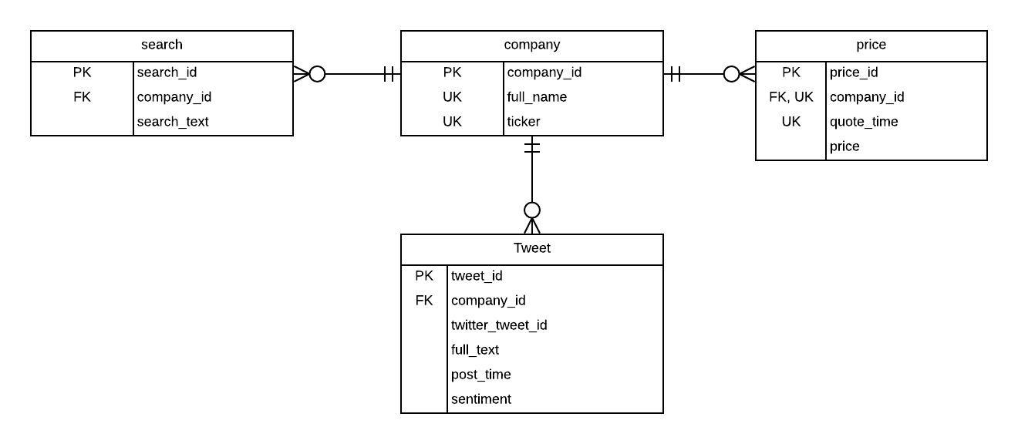
Database - Design

Slide 7
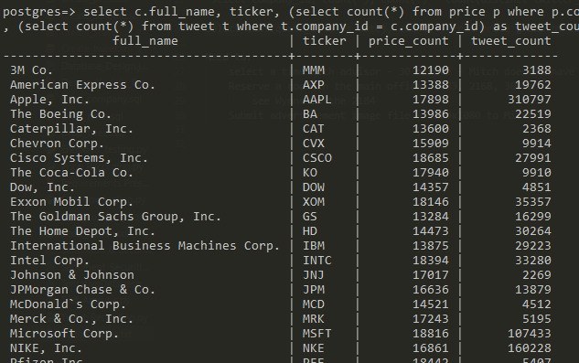
Database Details
Price
475,000+ between 10/3/2019 – 12/16/2019
Tweet
1,001,000+ between 11/3/2019 – 12/16/2019

Slide 8
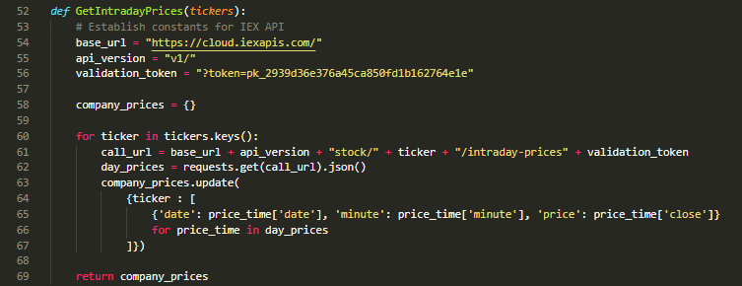
Price Recording
IEX Cloud API – financial information
Intraday Endpoint – returns price data for every minute
Python program running on AWS, calls endpoint at the end of each trading day

Slide 9
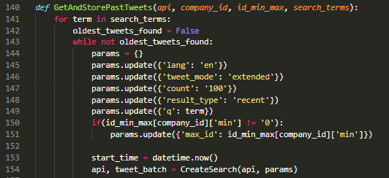
Tweet Recording
Twitter Developer Account
Search Endpoint – free tier limited in calls per minute, up to 7 days in past
Keep track of latest tweets currently in DB, search for more recent tweets
Run continuously on AWS

Slide 10
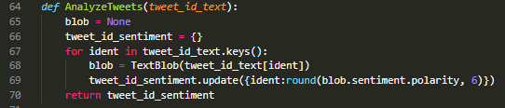
Text Analysis
TextBlob built on NLTK
Used pretrained model
(-1, 1) range on sentiment
Run periodically on local machine, updates existing DB rows

Slide 11
Data Visualization
Plotly – robust graphing and data vis tool for Python - https://plot.ly/
Dash – framework for web apps in Python - https://dash.plot.ly/
Written on top of Flask, Plotly.js, React.js
Interactive Visualization App
Selectable company, date, tweet visibility, tweet averaging
Statistics – counts, returns, average sentiment, daily change
Trading Strategy – daily returns when sentiment above threshold
Interactive table – daily statistics, sort, filter

Slide 12
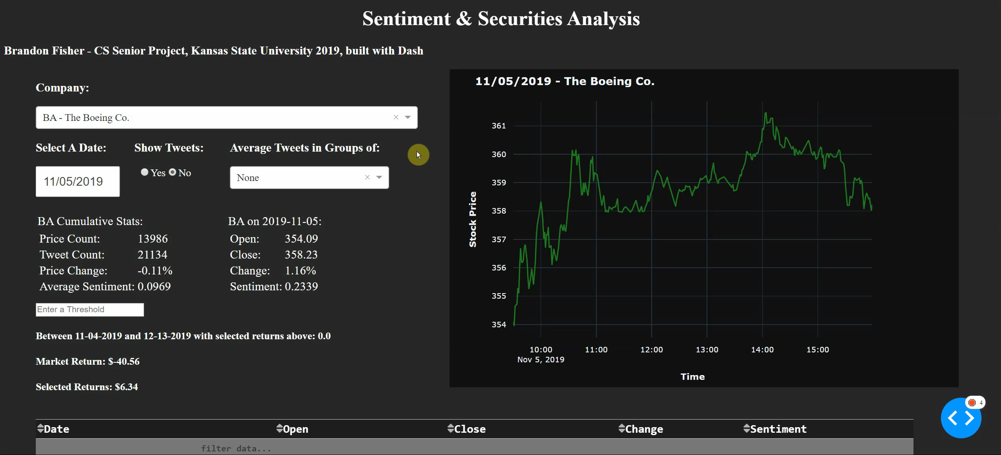
More Data Visualization

Slide 13
Results
Company | Market Return | Selected Return
MMM - 3M | $15.85 | $5.40
AXP – American Express | $11.60 | $1.44
AAPL – Apple | $61.70 | $0.01
BA – Boeing | $ - 40.56 | $6.32
CSCO – Cisco | $ - 0.12 | $ - 0.78
DOW – Dow | $9.42 | $ - 1.60
MCD – McDonald’s | $ - 8.51 | $ - 5.33
MSFT – Microsoft | $21.02 | $5.18
NKE – Nike | $7.61 | $0.30
DIS – Walt Disney Co. | $19.85 | $ - 4.72
Made Money vs. Market – 5
Lost Money vs. Market – 25

Slide 14
Challenges & Future Work
Text Encodings
Dates and Times, timezones!
Tweet searching
Looked for mentions @some_company
Is a tweet relevant?
Limitations of free tier endpoints
Upgrades
Real time streaming data
Trading simulation

Slide 15
Demo & Questions Go to 3.133.209.50

